Slide 1
Predictive Analysis of Crop Yield
TEAM MEMBERS:
Syed Ibrahim Hamza Pratik Shetty
Nithin Ravindra Reddy
Notes:
Hello everyone. Today, we will be presenting our final project titled “Predicting Global Crop Yield Using Machine Learning.” Our project focuses on understanding global agricultural productivity and using data-driven methods to forecast crop yield efficiently and sustainably.

Slide 2
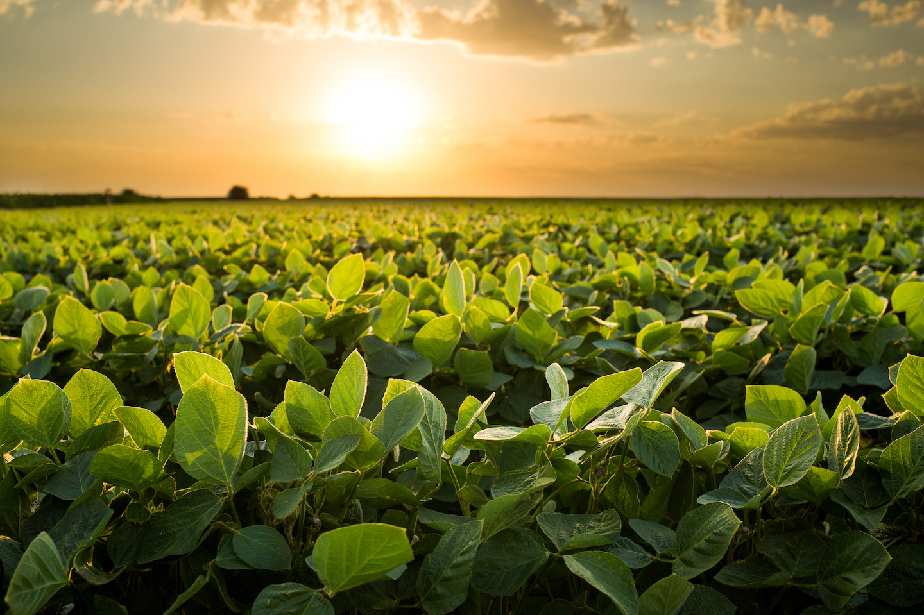
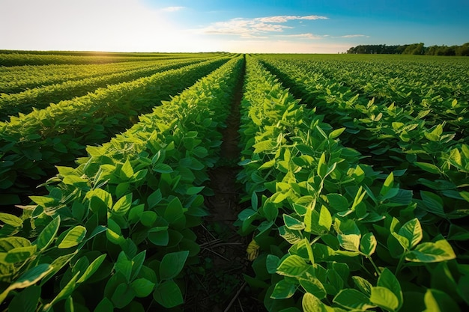
Introduction
Agriculture plays a vital role in the global economy, with food security depending on efficient crop production.
Yield prediction is crucial for farmers, policymakers, and researchers to optimize farming strategies.
Traditionally, yield estimation has relied on experience, but advancements in data science and machine learning now allow for more accurate predictions.
This project analyzes agricultural yield data using different predictive modeling techniques to extract meaningful insights and enhance decision-making.
Notes:
Agriculture is one of the most critical components of the global economy, directly impacting food security, environmental sustainability, and economic development. Traditionally, yield estimation has depended heavily on farmers’ experience or simple historical trends.
But today, with advancements in data science and machine learning, we can use large-scale environmental and agricultural datasets to create highly accurate prediction models.

Slide 3
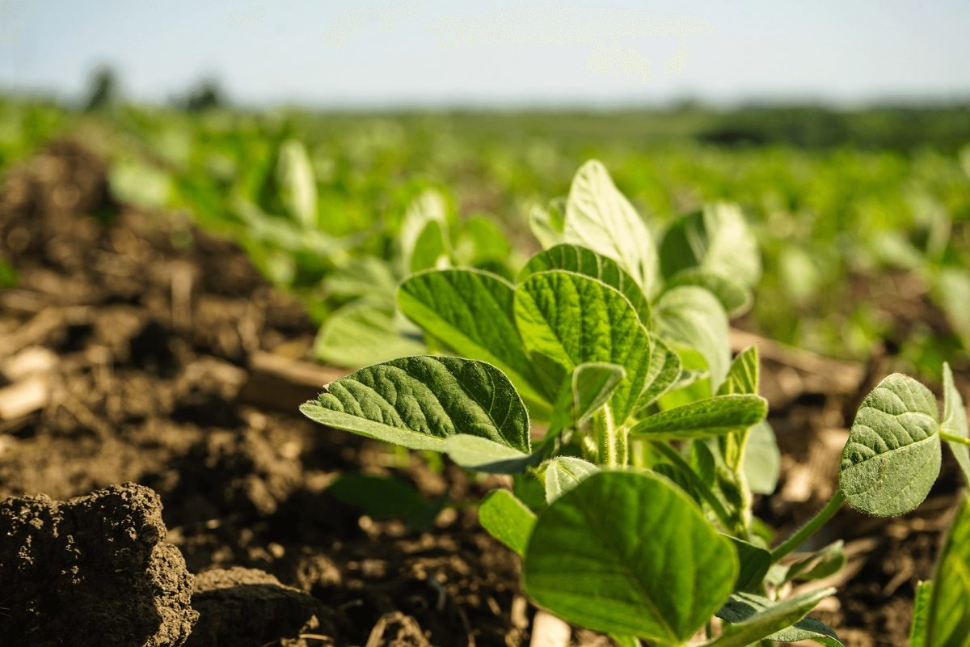
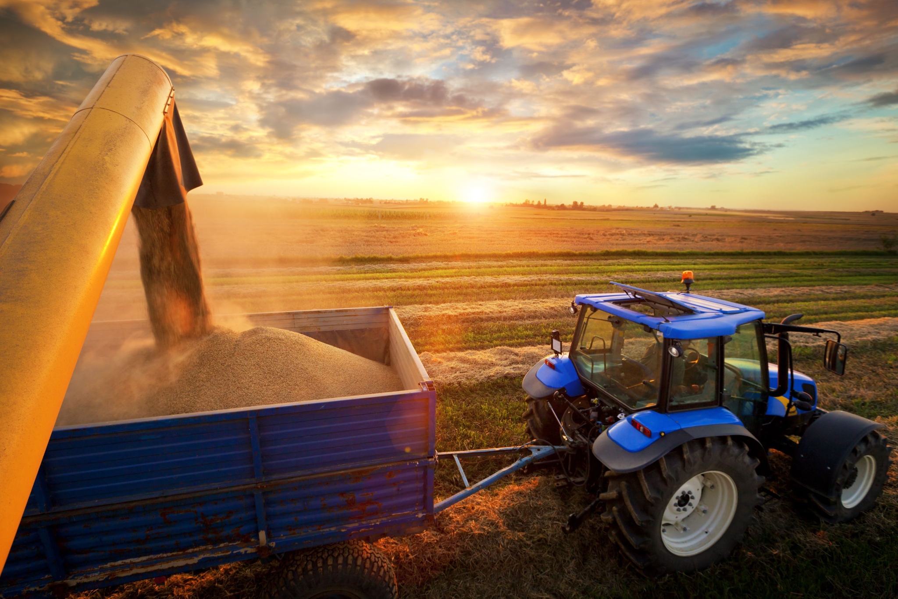
Problem Statement
Crop yields depend on climate, soil health, irrigation, and pesticide use.
Farmers struggle to predict yield variations, leading to inefficient resource use.
Misuse of pesticides, fertilizers, and irrigation harms both productivity and the environment.
A predictive system is needed to analyze historical data, identify key factors, and forecast yields accurately.
The goal is to provide data-driven insights to help farmers optimize practices and maximize yield.
Notes:
Crop yield is influenced by a combination of factors—climate conditions, soil health, irrigation, and pesticide usage. Because these variables interact in complex ways, farmers often struggle to accurately predict yield variations. To address this, we aim to build a predictive system that analyzes historical agricultural and environmental data, identifies the factors that matter most, and accurately forecasts crop yield.

Slide 4
Data Description and Cleaning
The dataset for this project was obtained from Kaggle, which aggregates publicly available data from reputable sources such as the Food and Agriculture Organization (FAO) and the World Bank.
It contains 28,242 records across 101 countries spanning the period from 1990 to 2013.
Variables:
◦ Area – Country or region (categorical) ◦ Item – Crop type (categorical) ◦ Year – Time period (categorical/numerical) ◦ average_rain_fall_mm_per_year – Average annual rainfall (continuous) ◦ pesticides_tonnes – Pesticide usage in tonnes (continuous) ◦ avg_temp – Average temperature (continuous) ◦ hg/ha_yield – Crop yield per hectare (continuous)
Notes:
Our dataset comes from Kaggle, which consolidates information from reputable sources like the FAO and the World Bank.
It contains 28,242 records from 101 countries, covering the period 1990 to 2013.

Slide 5
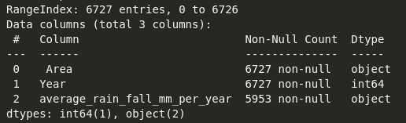
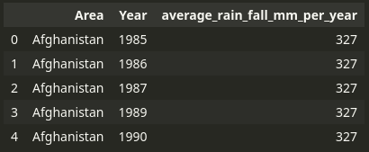
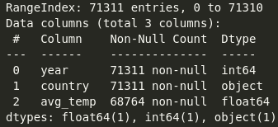
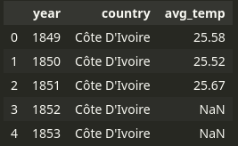
Data Description and Cleaning 2.0
Rainfall
Temperature
Notes:
Before analysis, we performed several cleaning steps:

Slide 6
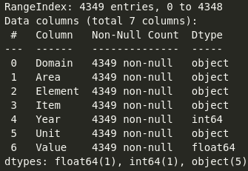
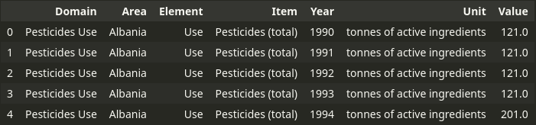
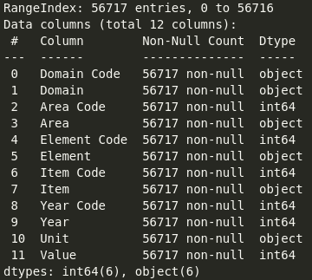
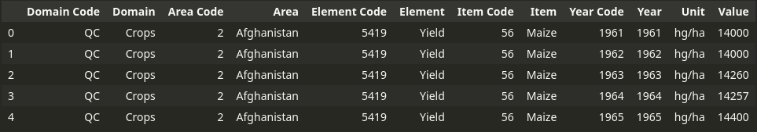
Data Description and Cleaning 3.0
Pesticides
Yield
Notes:
This ensured the dataset was consistent, balanced, and ready for exploration. Finally, we combined all the DF into one single DF.

Slide 7
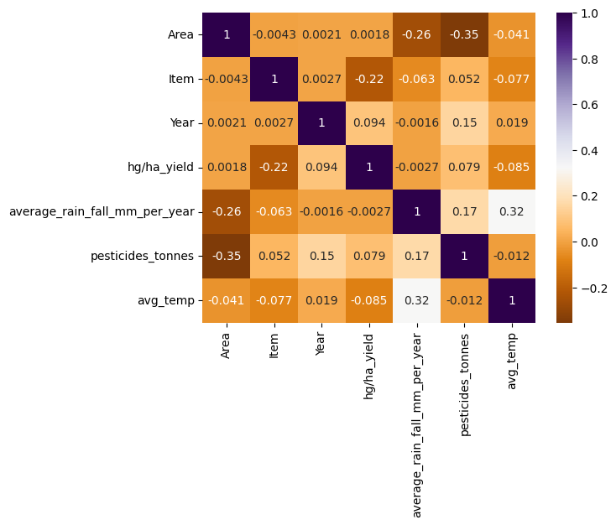
EDA
Displays the relationships between all variables, including the target yield (hg/ha_yield).
Highlights a moderate positive correlation (0.32) between pesticides_tonnes and crop yield, suggesting pesticide use is a factor, but not the only one.
Notes:
Plot 1 visualizes correlations between all variables, including the target yield. One important observation is the moderate positive correlation (0.32) between pesticide use and crop yield. This suggests pesticides influence yield, but they are certainly not the only factor—highlighting the need for multivariable models.

Slide 8
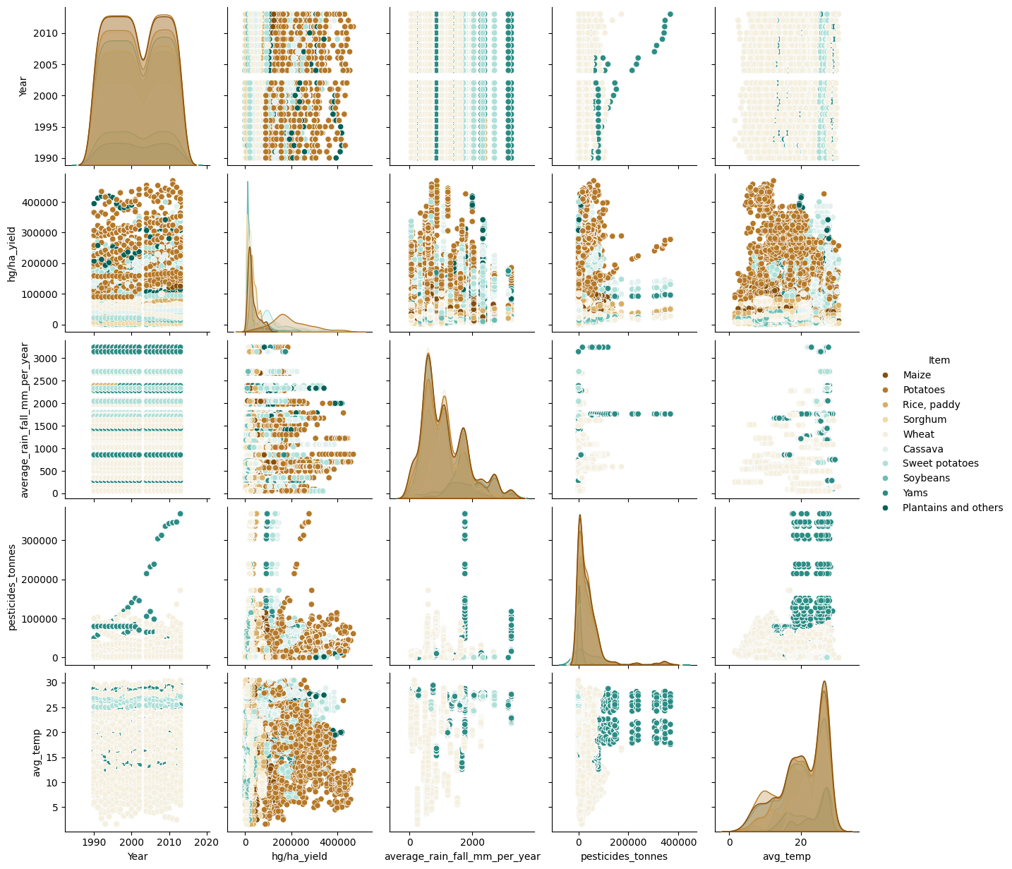
EDA 2.0
Visualizes the distribution of key variables (yield, rainfall, pesticides, temp) and their scatter plots, coloured by crop type (Item).
Crucial for identifying potential non-linear relationships and data clusters that regression models must account for.
Notes:
Plot 2 shows the distribution and interactions of rainfall, temperature, pesticides, and yield, colored by crop type.
This helps identify trends, clusters, and non-linear relationships.
For example, some crops clearly show tighter clusters, suggesting more predictable behavior, while others vary more widely.

Slide 9
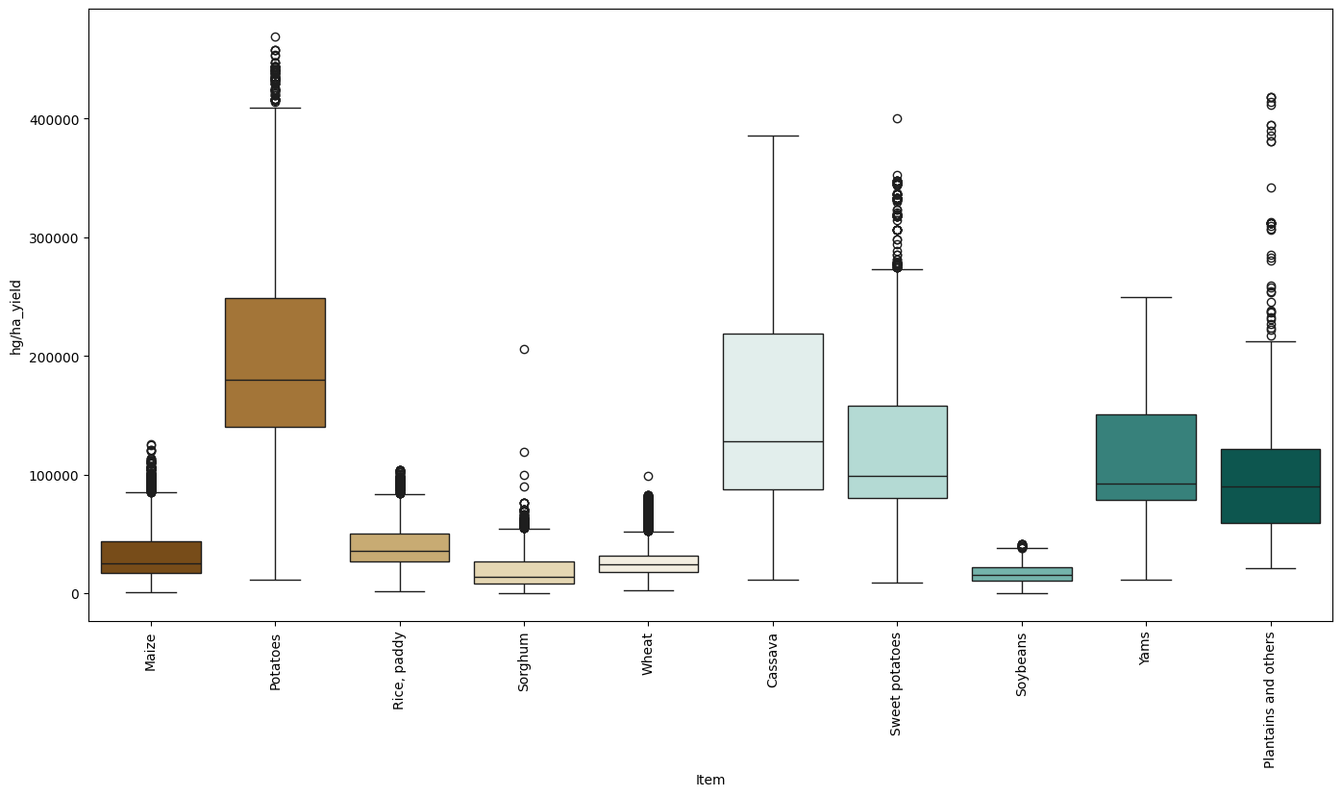
EDA 3.0
Clearly shows the high variability and presence of outliers in yield for crops like Potatoes and Cassava.
Potatoes and Plantains have the highest median yields, setting a benchmark for target production levels in prescriptive analysis.
Notes:
Plot 3 reveals yield var iability across crop types. Crops like Potatoes and Cassava have significant outliers, while Potatoes and Plantains show the highest median yields. These crops set a benchmark for high-yield potential in subsequent prescriptive analysis.

Slide 10
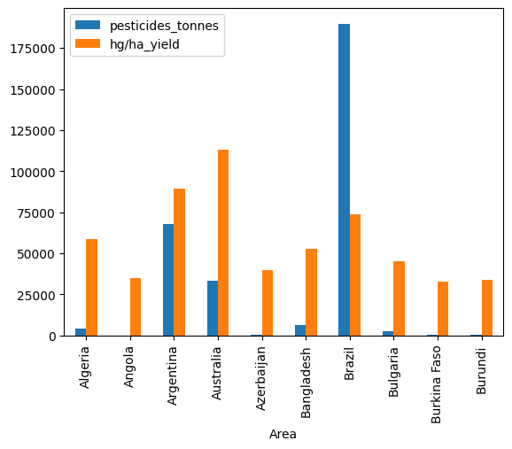
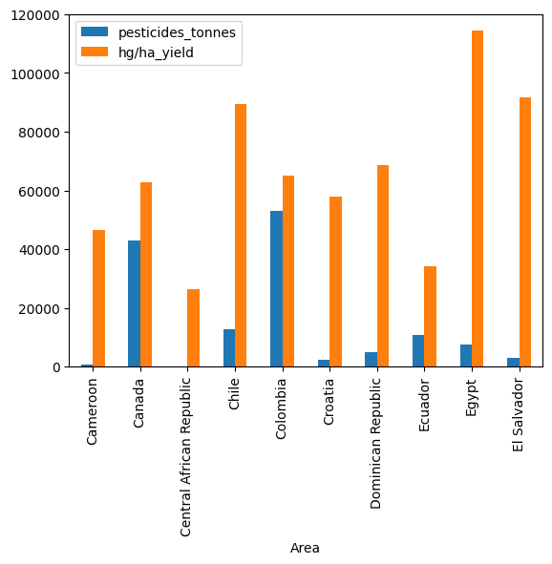
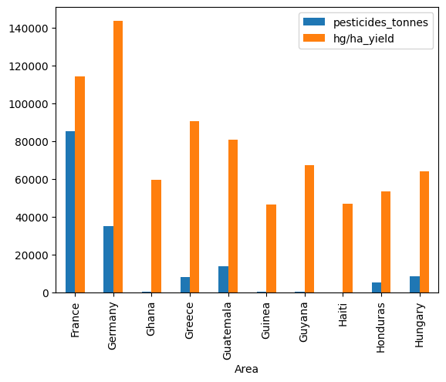
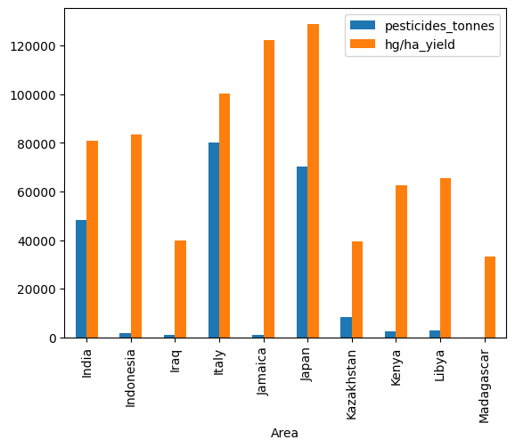
EDA 4.0
Compares the average input (pesticides) against the average output (yield) for different countries in groups.
Notes:
Plot 4 compares average pesticide use with average yield across countries.
This allows us to identify high-efficiency countries, such as Australia, which achieve high yield with relatively low pesticide usage.

Slide 11
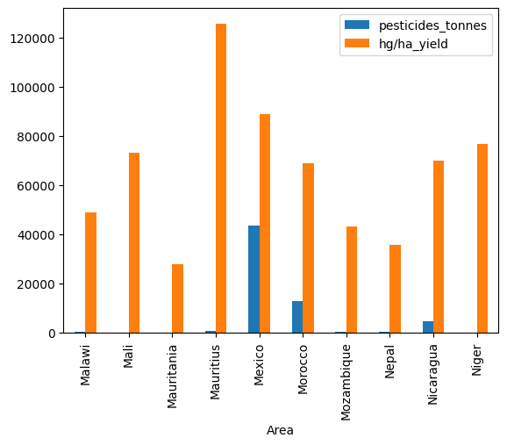
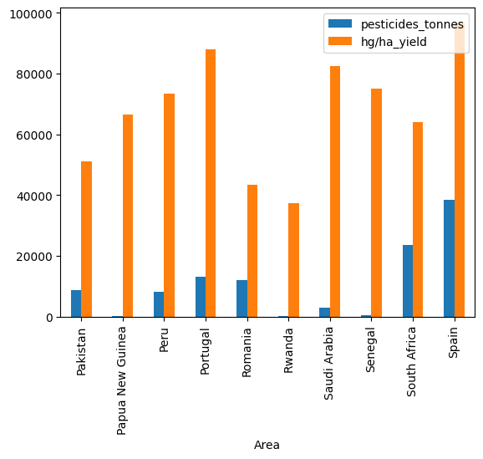
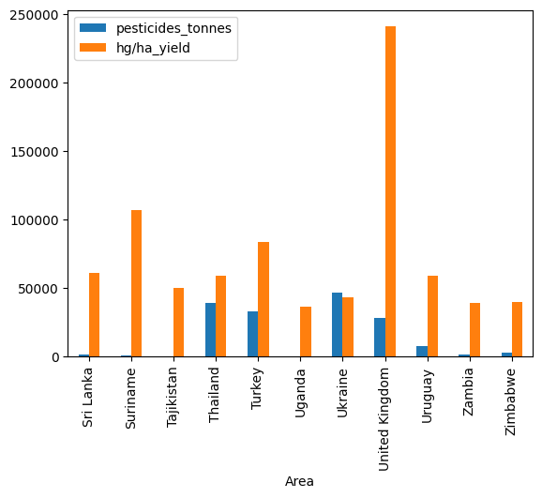
EDA 5.0
Identifies countries (e.g., Australia) with high yield relative to pesticide use as high-efficiency or sustainable farming regions.
Notes:
These insights help highlight sustainable farming conditions worldwide.

Slide 12
Methods used for Analysis
Linear Regression
Gradient Boost
K-Nearest Neighbors (KNN)
Decision Tree
Random Forest
XGBoost
Bagging Regressor
Notes:
In this slide, we summarize the machine learning and statistical models applied in our project.
We used a wide range of algorithms—from simple linear models to more complex ensemble methods.
This helps us compare performance across different levels of model complexity.
Models like Linear Regression give interpretability, while tree-based models such as Random Forest, XGBoost, and Gradient Boosting often capture non-linearities better.
By testing multiple approaches, we ensure we select the best-performing and most reliable model for yield prediction.

Slide 13
To extract meaningful insights and make predictions, we utilized the following analytical methods:
1)Descriptive Analysis: Understanding basic dataset characteristics through statistical measures, distributions, and trends.
2)Diagnostic Analysis: Identifying relationships between factors (e.g., correlation between temperature and yield) using regression analysis and feature importance techniques.
3)Predictive Analysis: Implementing machine learning algorithms such as Linear Regression, Decision Trees, and Random Forests to forecast crop yield based on historical data.
4)Prescriptive Analysis: Using data-driven insights to provide recommendations on farming strategies, such as ideal pesticide levels or irrigation adjustments.
Notes:
Our analysis follows four main analytical approaches:
Descriptive Analysis to understand basic dataset patterns, distributions, and trends.
Diagnostic Analysis to identify relationships between factors—for example, how temperature or pesticide use affects yield.
Predictive Analysis, where we apply machine learning models to estimate yield based on environmental and agricultural variables.
Prescriptive Analysis, where we use the model’s insights to provide actionable farming recommendations—things like optimal pesticide or temperature ranges for higher yield. This structured framework allows us to move from raw data to decision-making.
Our analysis follows four main analytical approaches:
Descriptive Analysis to understand basic dataset patterns, distributions, and trends.
Diagnostic Analysis to identify relationships between factors—for example, how temperature or pesticide use affects yield.
Predictive Analysis, where we apply machine learning models to estimate yield based on environmental and agricultural variables.
Prescriptive Analysis, where we use the model’s insights to provide actionable farming recommendations—things like optimal pesticide or temperature ranges for higher yield. This structured framework allows us to move from raw data to decision-making.

Slide 14
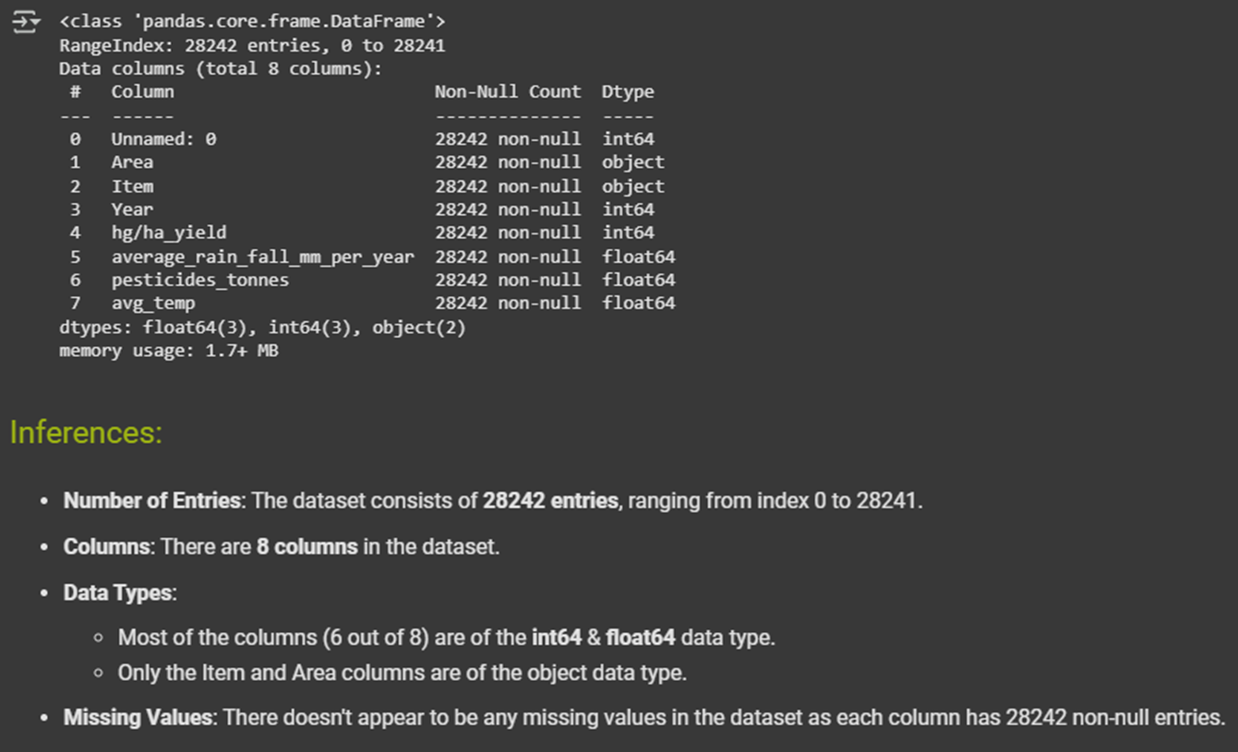
Descriptive Analysis
Dataset Summary
and Inferences
Notes:
At this stage, we focus on understanding the data at a high level. We summarize variables such as rainfall, temperature, pesticide usage, and yield. This gives us an initial sense of trends—for example, which crops tend to have higher yields, which countries apply more pesticides, or how weather varies across regions. These summaries establish a foundation before we move into more complex modeling.

Slide 15
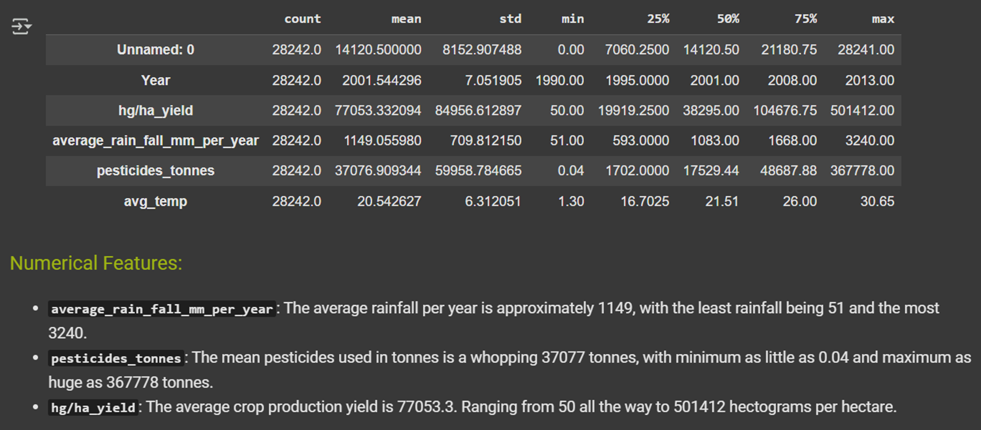
Descriptive Analysis
Notes:
This slide shows statistical summaries and visualizations that help us identify ranges, outliers, and distributions. For example, yield data shows significant variability, and some crops have extreme values. Understanding these patterns early prevents issues like model bias or skewed results later on. It also helps us detect whether any preprocessing is needed.

Slide 16
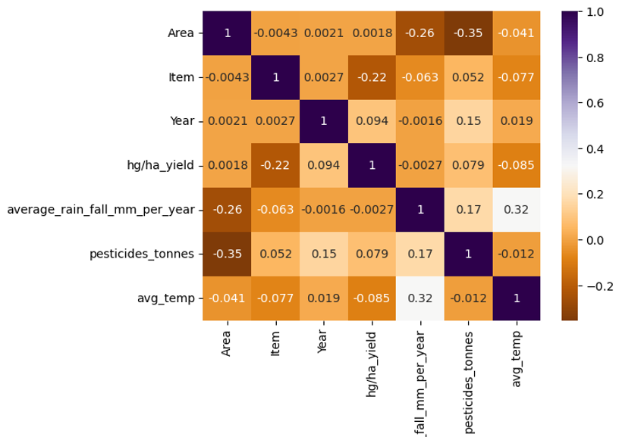
Diagnostic Analysis
Correlation between columns
Notes:
Diagnostic analysis focuses on understanding why certain patterns occur.
This correlation heatmap helps us see which variables are strongly related.
For example, pesticide usage and yield show a moderate relationship, but rainfall and temperature also contribute meaningfully.
This step helps us identify which variables may be important predictors in our models.

Slide 17
Performance Evaluation of Models

Slide 18
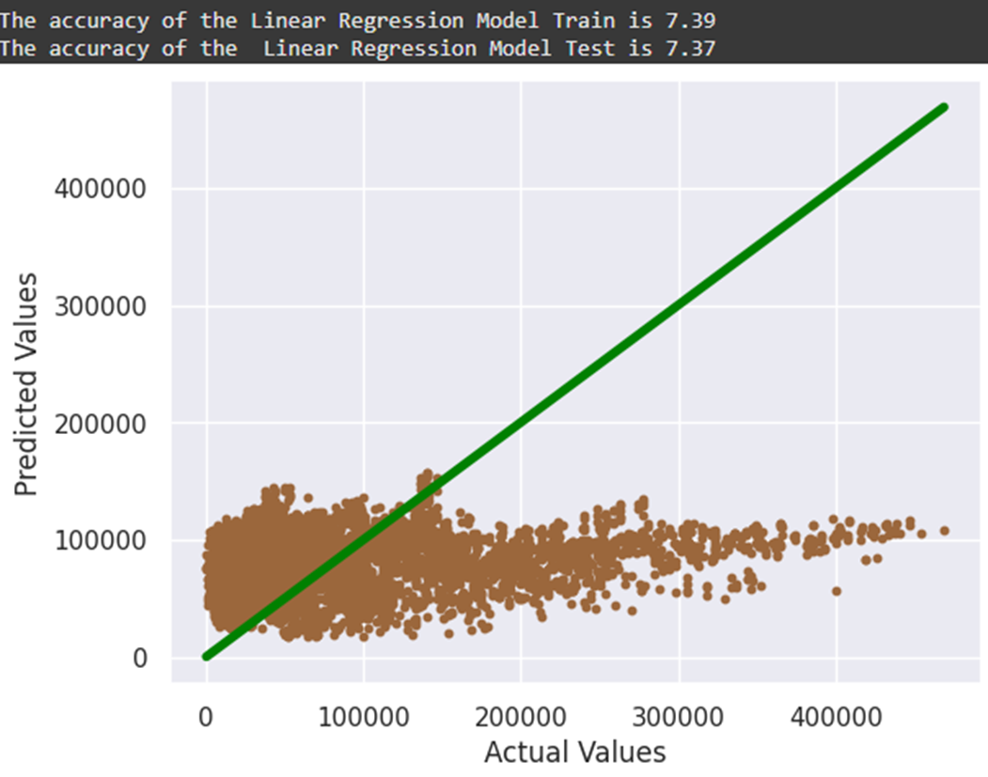
Linear Regression Model
Notes:
Linear Regression gives us a baseline. It assumes a straight-line relationship between inputs and yield. While it’s simple and interpretable, crop yield often depends on variables that interact in more complex ways. The model performed reasonably but didn’t fully capture non-linear relationships in the data.

Slide 19
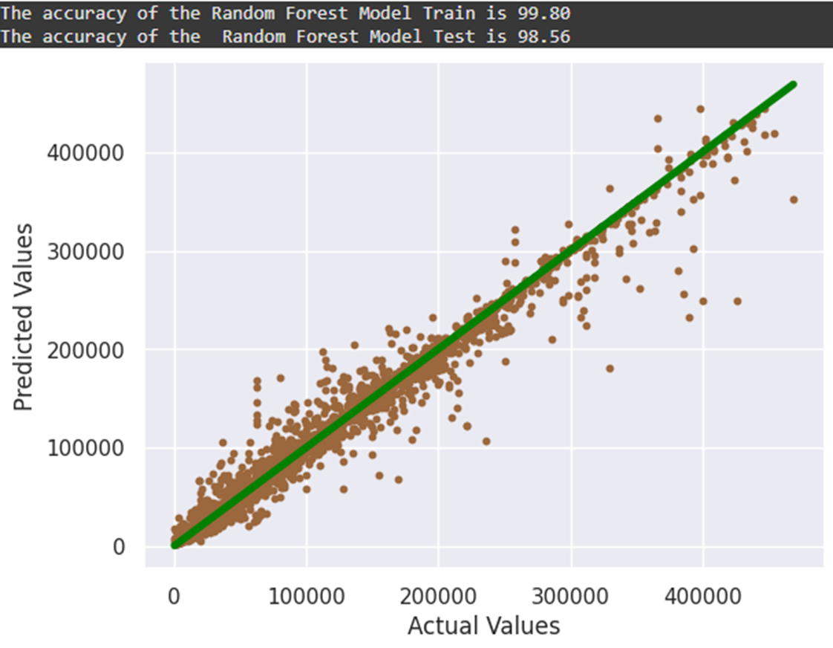
Random Forest Model
Notes:
Random Forest performed significantly better than linear models. It builds multiple decision trees and aggregates their outputs, which improves accuracy and reduces overfitting. It captures non-linear relationships well. This model showed strong predictive power, making it one of our top contenders.

Slide 20
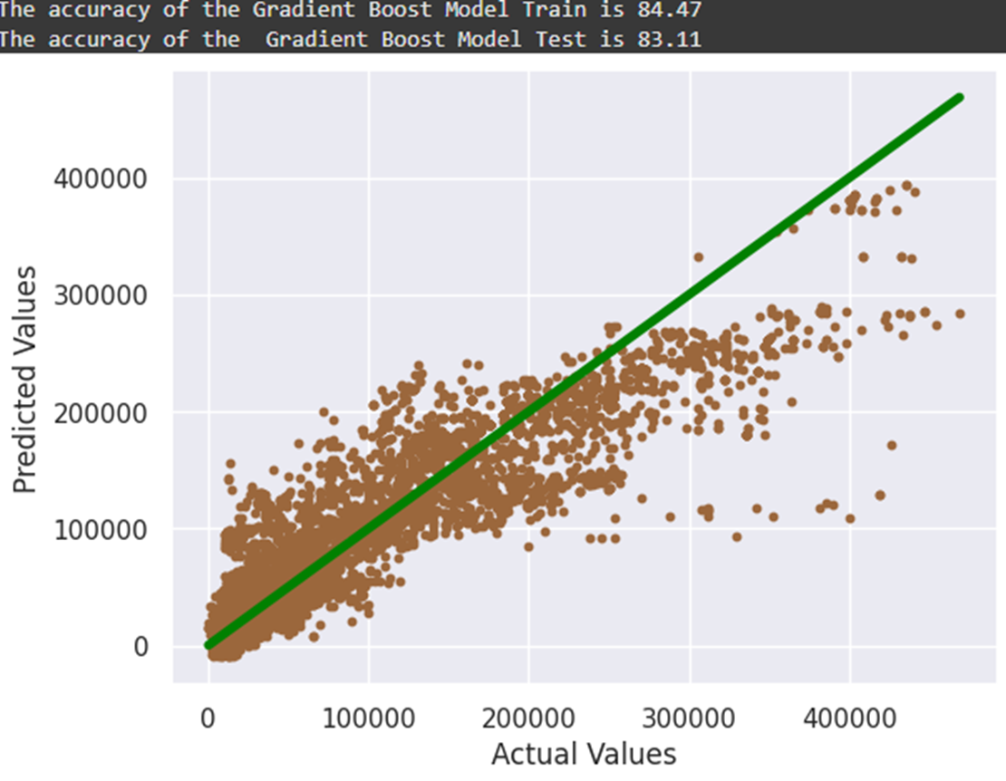
Gradient Boosting Model
Notes:
Gradient Boosting builds trees sequentially, correcting previous errors. This tends to produce highly accurate models. It performed very strongly but required careful tuning to avoid overfitting. Its strength is in capturing subtle interactions between variables.

Slide 21
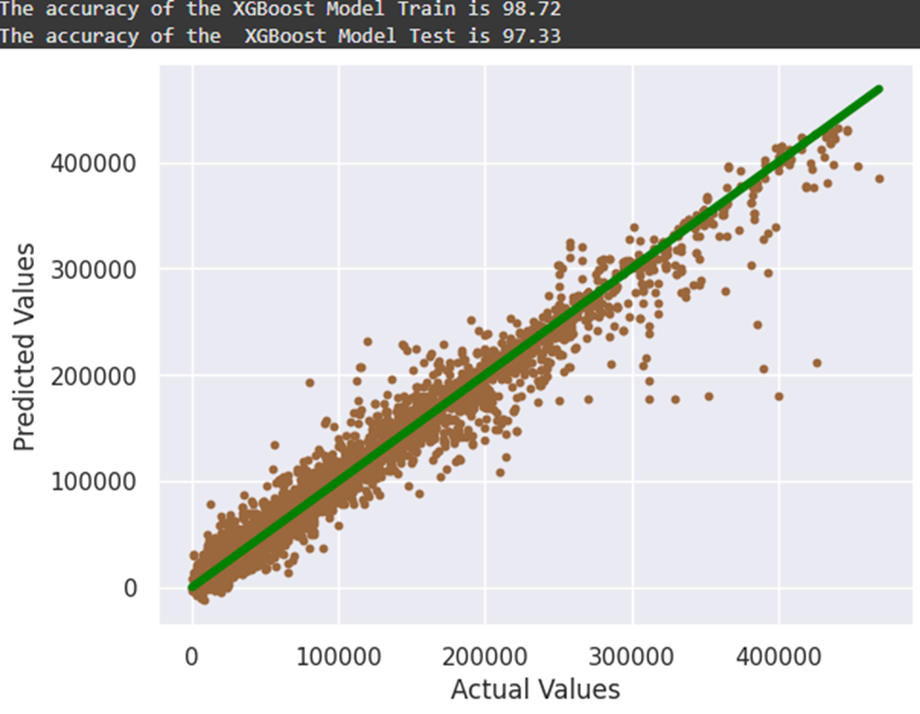
Extreme Gradient Boosting Model (XGBoost)
Notes:
XGBoost is an optimized version of Gradient Boosting—it’s known for high performance in structured datasets like ours. It provided some of the best predictive results among the ensemble models. Its ability to handle missing values, regularization, and efficient computation made it a strong candidate.

Slide 22
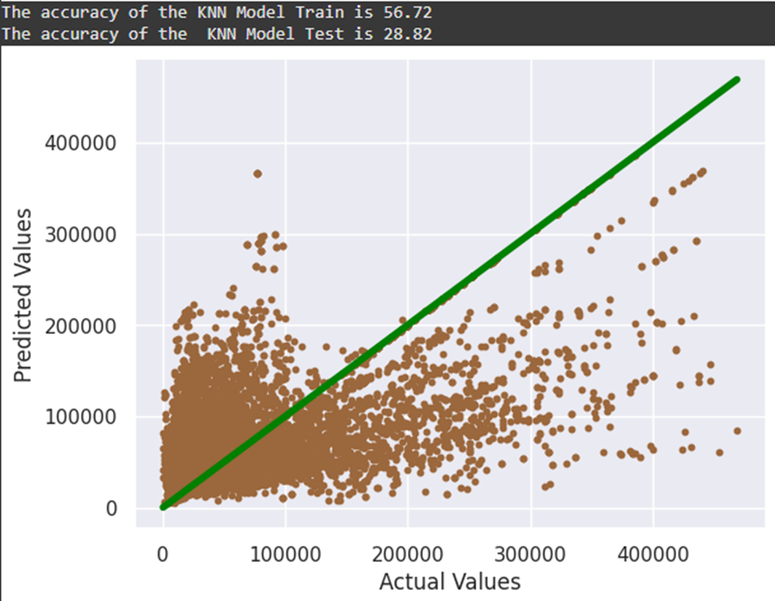
K-Nearest Neighbours Model (KNN)
Notes:
KNN predicts yield based on the most similar data points. It’s simple and intuitive but struggled with a dataset of this size and complexity. High dimensionality and large sample size make distance-based models less effective. So while useful for comparison, it wasn’t among our top models.

Slide 23
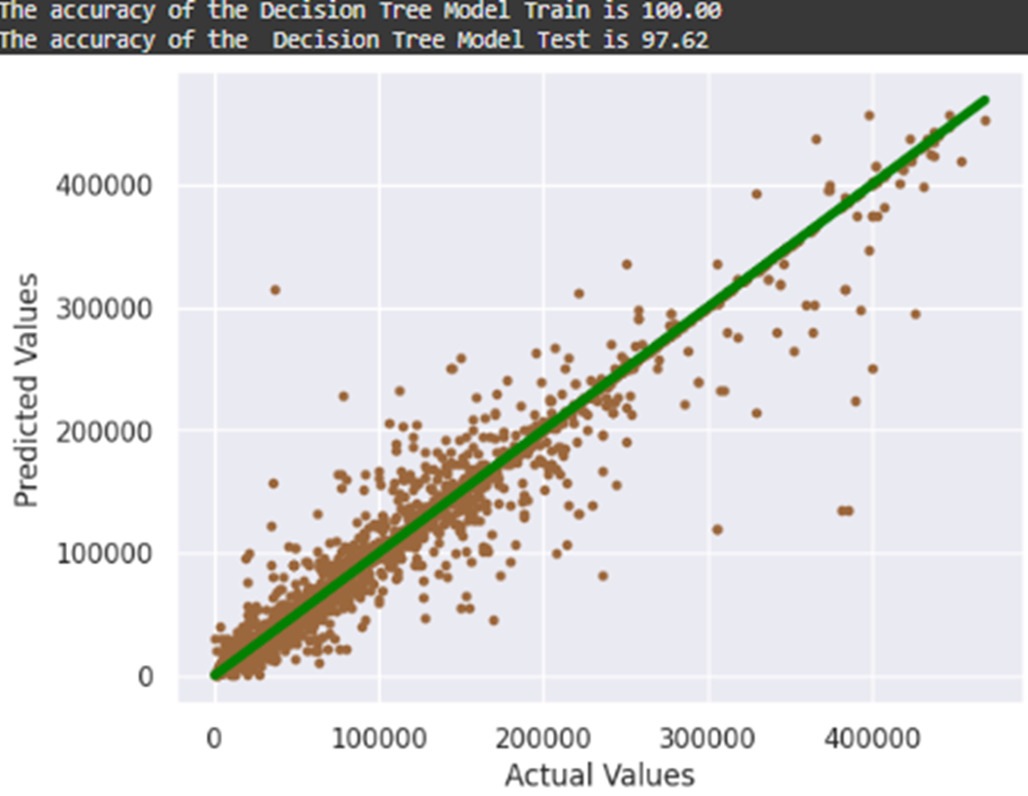
Decision Tree Model
Notes:
Decision Trees are easy to interpret and visualize but tend to overfit when used alone.
In our case, the Decision Tree model performed moderately well but lacked the stability and generalization of ensemble methods.
This is why techniques like Random Forest or Bagging often outperform single trees.

Slide 24
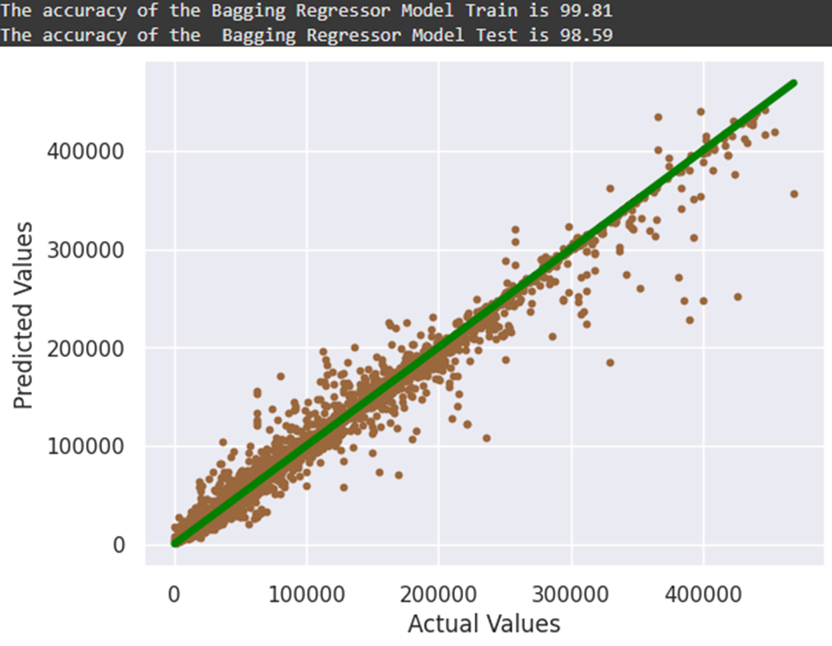
Bagging Regressor Model
Notes:
Bagging, or Bootstrap Aggregation, reduces variance by training multiple models on different subsets of the data. This improved model stability and accuracy compared to a single decision tree. However, it still performed slightly below Random Forest and XGBoost.

Slide 25
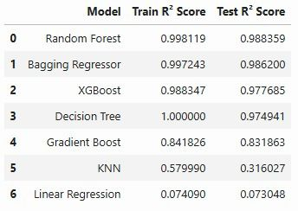
Results Summary
Notes:
This slide summarizes how all models performed based on R², RMSE, and generalization behavior. Models like Random Forest, Gradient Boost, and XGBoost delivered the highest accuracy. Linear and KNN models performed the least effectively on this dataset. This comparison allows us to confidently choose a model for prediction and prescriptive analysis.

Slide 26
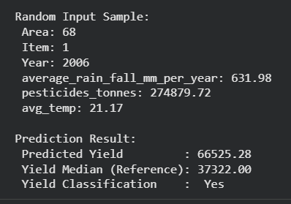
Predictive Analysis
Sample Prediction Output
with Yield Classification
Notes:
Using our best-performing model, we generate predictions for crop yield based on input variables. The sample output shown here demonstrates how the model assigns a predicted yield value for specific environmental conditions. This moves us from analysis to practical forecasting, which can support real-world agricultural decision-making.

Slide 27
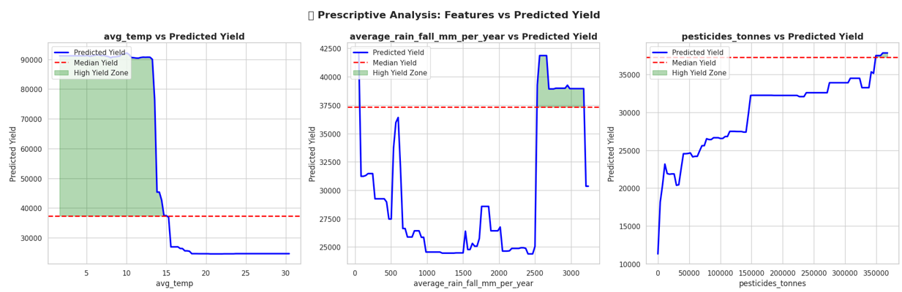
Prescriptive Analysis
Feature Impact on Predicted Yield
Notes:
Here, we analyze which factors have the highest influence on yield. Models like Random Forest and XGBoost provide feature importance rankings. Pesticides, temperature, and rainfall generally emerged as the strongest predictors. This helps us understand which inputs matter most when optimizing yield.

Slide 28
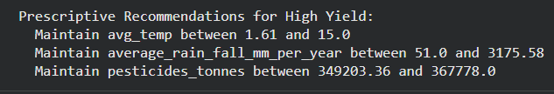
Prescriptive Analysis
Prescriptive Recommendations for High Yield
Notes:
This slide outlines actionable recommendations based on our prescriptive analysis. Using model insights, we identify optimal input levels for maximizing yield—for example:
minimal effective pesticide usage
ideal temperature and rainfall ranges
crop-specific recommendations These insights help guide sustainable agricultural practices and efficient resource use.

Slide 29
Conclusion
●This study demonstrated how data-driven approaches can enhance agricultural productivity by accurately predicting crop yield.
●Machine learning models provided valuable insights into key factors affecting yield, helping farmers make informed decisions.
●The findings emphasize the importance of data collection and real-time monitoring to further refine prediction accuracy.
●Future Improvements:
- Incorporating more granular data such as soil composition and humidity levels.
- Real-time IoT-based data collection for continuous monitoring and prediction.
●By integrating advanced data science techniques, the agricultural sector can move towards more sustainable and efficient farming practices.
Notes:
To conclude, our study demonstrates how data-driven approaches can significantly enhance agricultural productivity. Machine learning models help identify the key factors influencing yield, enabling farmers to make informed decisions. We also recognize limitations and propose improvements—such as incorporating soil data, humidity, and real-time IoT sensors. Ultimately, this project shows how advanced analytics can support sustainable, efficient farming practices worldwide. Thank you for listening.

Slide 30
THANK YOU

